Slide 1


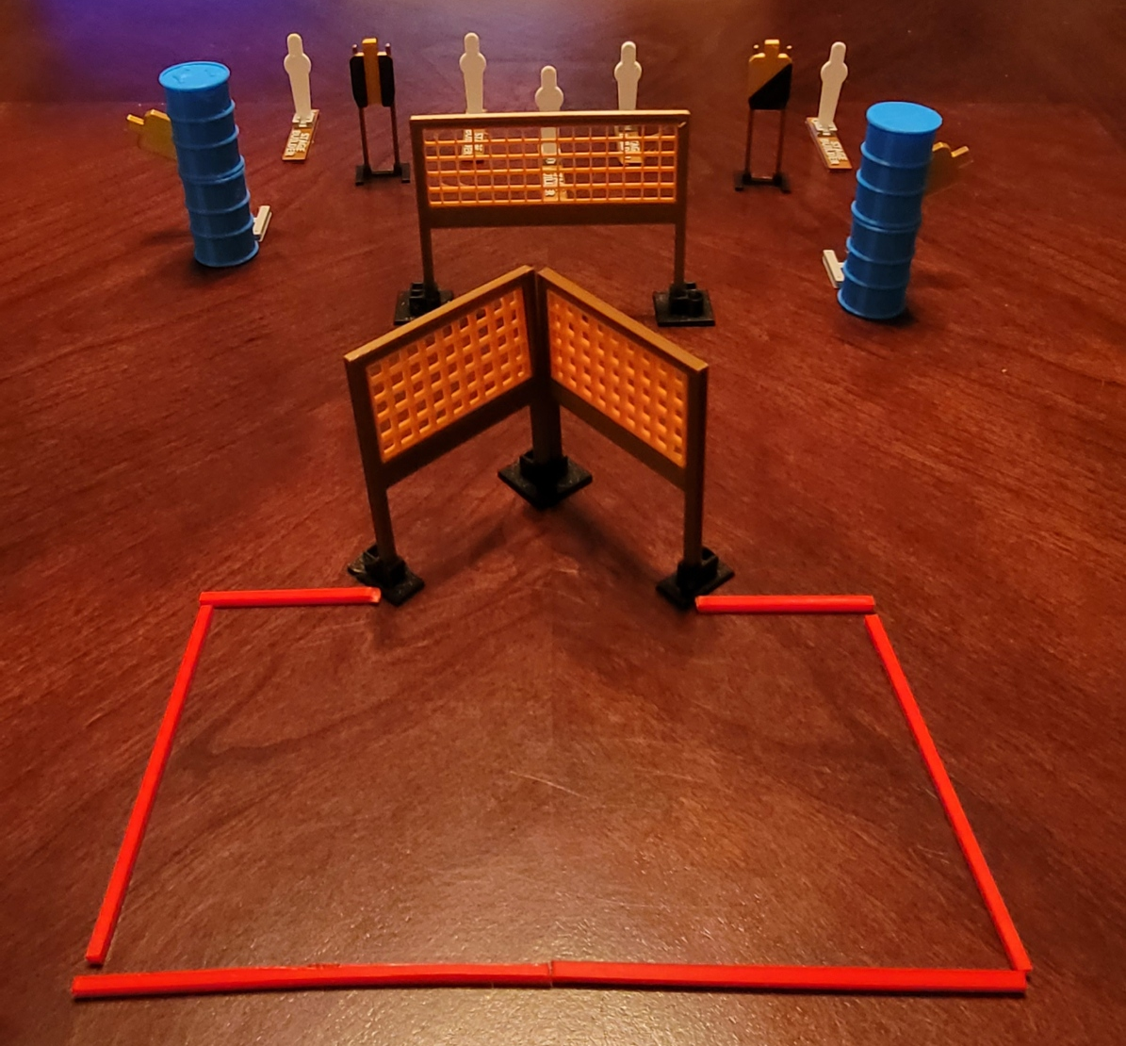
 | Dothan Gun Club – USPSA Match Gotta Go For Four Course Designer : Drew Coleman Bay: A1
Round Count 13 rounds 4 USPSA 5 colt poppers
Equipment List 5 wall feet 2 swingers + activators 1 tux, 1 right diag 2 targets

Slide 2
Gotta Go For Four
Written Stage Briefing
Scoring: Comstock Rounds: 13
Targets: 4 USPSA, 5 steel
Handgun start position: anywhere completely outside the shooting area, wrists below belt. Handgun is loaded and holstered.
PCC start position: anywhere completely outside the shooting area, stock on belt. Loaded carbine is held with both hands, safety on.
Stage Procedure: on the audible start signal, engage targets as they become available from within the shooting area.
Swingers are activated by poppers and remain visible at rest.

Slide 3
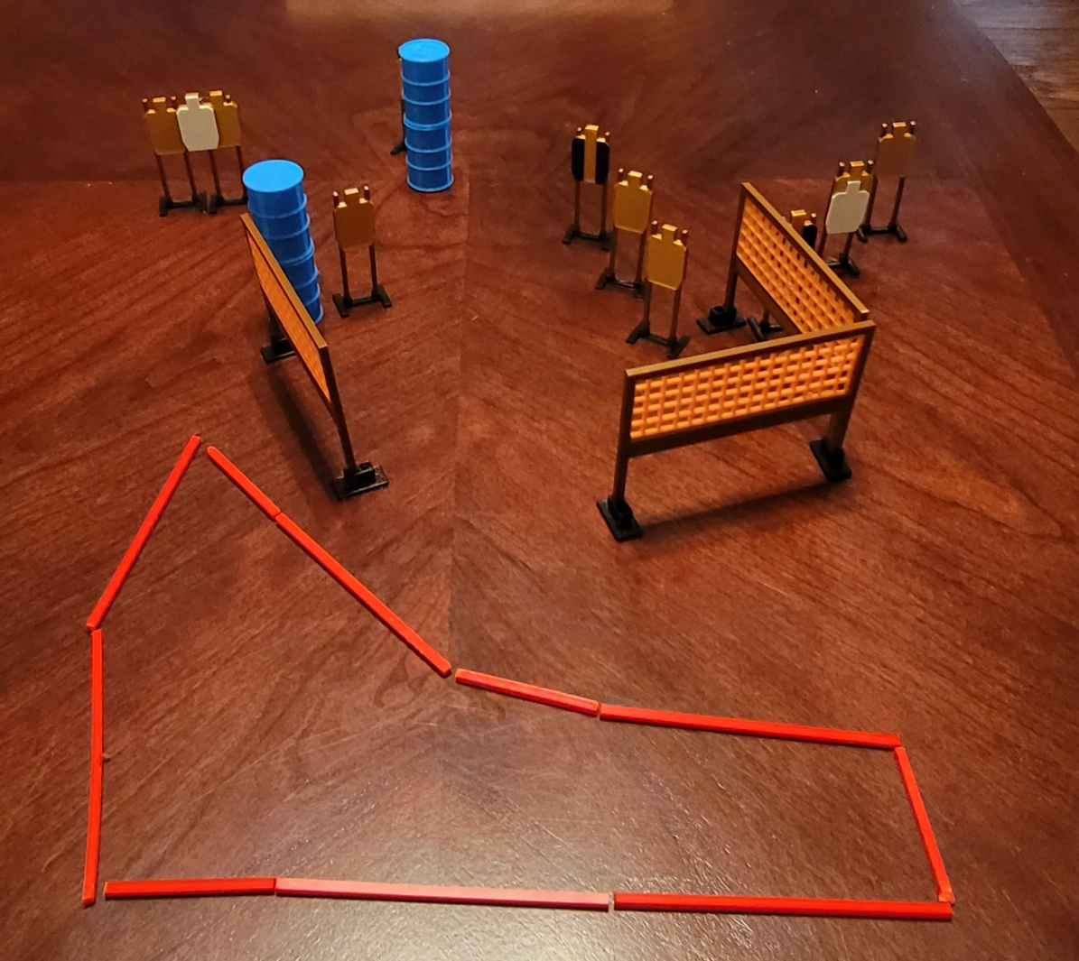
 | Dothan Gun Club – USPSA Match Middle Money Course Designer : Eric Henwood Bay: B1
Round Count 20 rounds 10 USPSA
Equipment List 5 wall feet 2 tux 10 targets (8 + 2 NS)

Slide 4
Middle Money
Written Stage Briefing
Scoring: Comstock Rounds: 20
Targets: 10 USPSA
Handgun start position: anywhere inside the shooting area, wrists below belt. Handgun is loaded and holstered.
PCC start position: anywhere inside the shooting area, stock on belt. Loaded carbine is held with both hands, safety on.
Stage Procedure: on the audible start signal, engage targets as they become available from within the shooting area. The last three targets must only be engaged strong hand only.

Slide 5
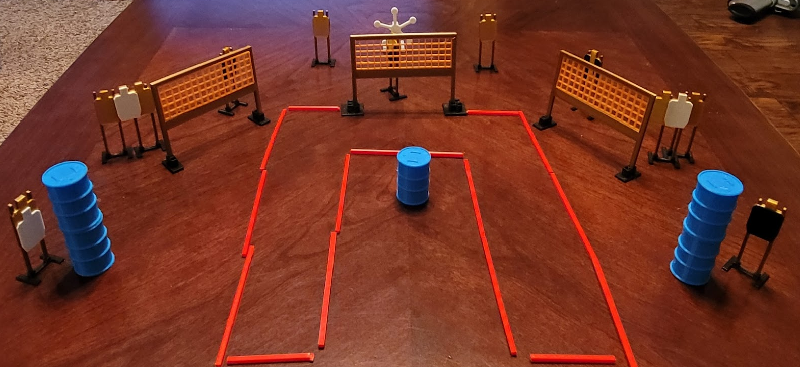
 | Dothan Gun Club – USPSA Match U’re A Star Course Designer : Eric Henwood Bay: A2
Round Count 27 rounds 11 USPSA 5 plates
Equipment List 6 wall feet Texas star 2 tux, 1 headshot, 1 right diag 10 targets (7 + 3 NS)

Slide 6
U’re A Star
Written Stage Briefing
Scoring: Comstock Rounds: 27
Targets: 11 USPSA, 5 steel
Start position: feet on marks, hands touching knees. Firearm is unloaded on barrel, unsupported, trigger guard on mark, muzzle pointed generally at cone. All magazines must start on barrel.
Stage Procedure: on the audible start signal, engage targets as they become available from within the shooting area.

Slide 7
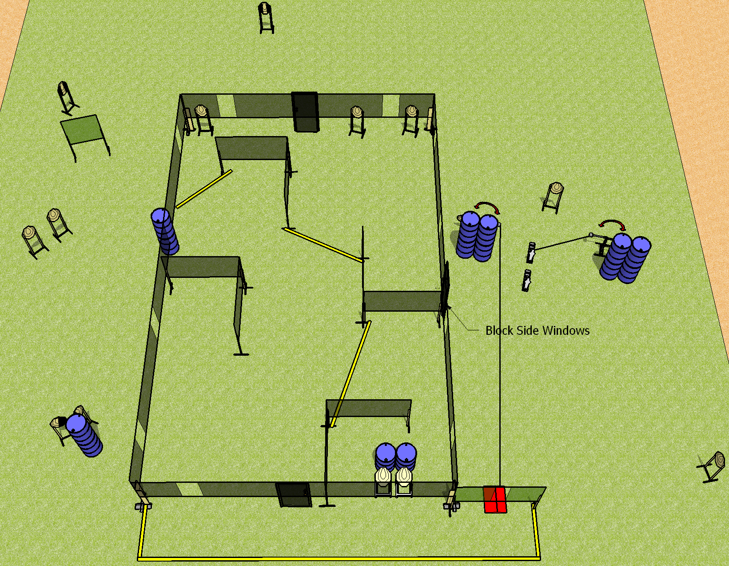
 | Dothan Gun Club – USPSA Match Call Your Shots Course Designer : Drew Coleman Bay: A4
Round Count 32 rounds 15 IPSC 2 mini poppers
Equipment List 4 wall feet 1 swinger + activator, stomp pad, drop turner 1 left + 1 right diag, 1 tux

Slide 8
Call your Shots
Written Stage Briefing
Scoring: Comstock Rounds: 32
Targets: 15 IPSC, 2 steel
Handgun start position: anywhere inside the shooting area, wrists below belt. Handgun is loaded and holstered.
PCC start position: anywhere inside the shooting area, stock on belt. Loaded carbine is held with both hands, safety on.
Stage Procedure: On the audible start signal, engage targets as they become available from within the shooting area. Swinger 1 is activated by the stomp pad and remains visible at rest. Drop turner is activated by P2 and remains visible at rest.

